Slide 1
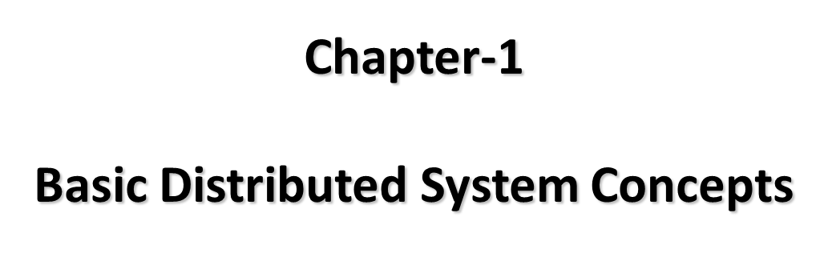
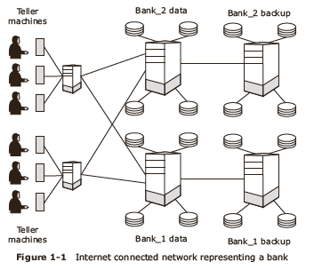
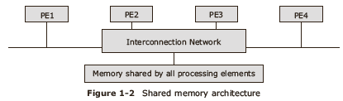
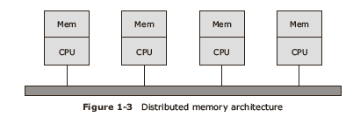
What is a distributed system?
Tanenbaum’s definition of a distributed system: “
A distributed system is a collection of independent computers that appear to the users of the system as a single coherent system.”
An example of a Distributed System
Nationalized Bank with multiple Branch Offices
Requirements of Distributed systems
Security and reliability.
Consistency of replicated data.
Concurrent transactions (operations that involve accounts in different banks; simultaneous access from several users, etc)
Fault tolerance
Architectures for Distributed systems
Shared memory architectures / Tightly coupled systems
  easier to program
Distributed memory architectures / Loosely coupled systems
  offer a superior price performance ratio and are scalable

Slide 2
Distributed Computing Models
Workstation model
Workstation–server model
Processor-pool model

Slide 3
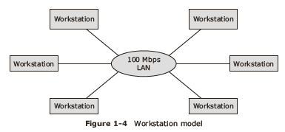
Workstation model
Consists of network of personal computers,
Each one with its own hard disk and local file system
Interconnected over the network

Slide 4
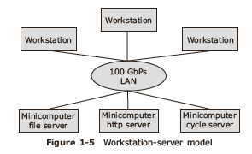
workstation-server model
Consists of multiple workstations coupled with powerful servers with extra hardware to store the file systems and other software like databases

Slide 5
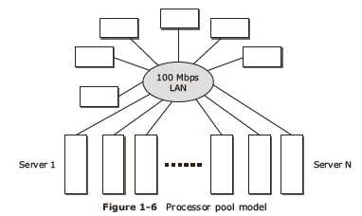
processor-pool model
consists of multiple processors: a pool of processors and a group of workstations

Slide 6
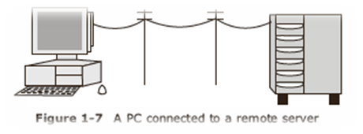
Advantages of Distributed systems
Inherently distributed applications
Information sharing among geographically distributed users
Resource Sharing
Better price performance ratio
Shorter response time & higher throughput
Higher reliability and availability against component failures
Extensibility and Incremental Growth
Better Flexibility

Slide 7
Disadvantages of Distributed systems
Relevant software does not exist currently
Security poses a problem due to easy access to all data
Networking saturation may cause a hurdle in data transfer.

Slide 8
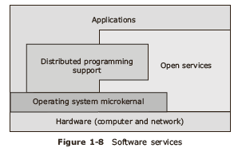
Software concepts
Network Operating System (NOS)
Distributed Operating System (DOS)
Multiprocessor Time Sharing System

Slide 9
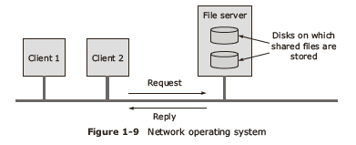
Network Operating System (NOS)
Build using a distributed system from a network of workstations connected by high speed network.
Each workstation is an independent computer with its own operating system, memory and other resources like hard disks, file system and databases

Slide 10
Distributed Operating System (DOS)
Enables a distributed system to behave like a virtual uniprocessor even though the system operates on a collection of machines.
Characteristics
  enabling Inter process communication,
  Uniform process management mechanism,
  Uniform and visible file system,
  Identical kernel implementation,
  Local control of machines
  handling scheduling issues.

Slide 11
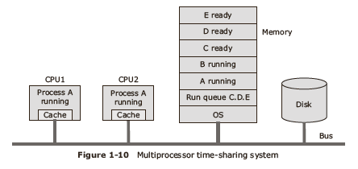
Multiprocessor Time Sharing System
Combination of tightly coupled software and tightly coupled hardware with multiple CPUs projecting a uniprocessor image.
Tasks are queued in shared memory and are scheduled to be executed in time shared mode on available processors.

Slide 12
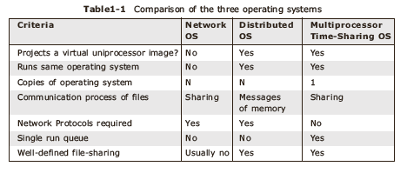
Comparison of different Operating systems
Software Concepts

Slide 13
Issues in Designing Distributed systems
Transparency
Flexibility
Reliability
Performance
Scalability
Security

Slide 14
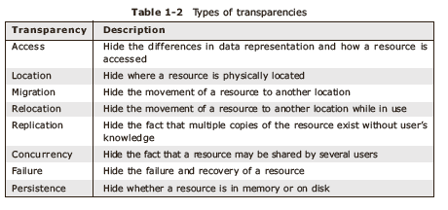
Transparency
Transparencies required for Distributed Systems

Slide 15
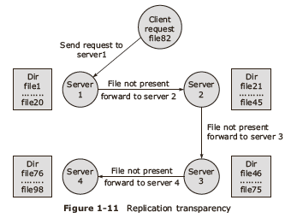
Replication Transparency
Locating Replicated File stored on any server

Slide 16
Flexibility
Monolithic kernel approach
Microkernel approach

Slide 17
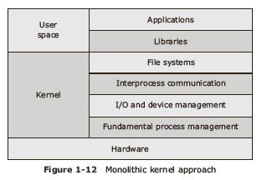
Monolithic kernel approach
uses the minimalist , modular approach with accessibility to other services as needed.

Slide 18
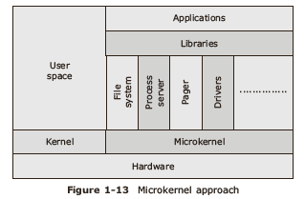
Microkernel approach
uses the kernel does it all approach with all functionalities provided by the kernel irrespective whether all machines use it or not

Slide 19
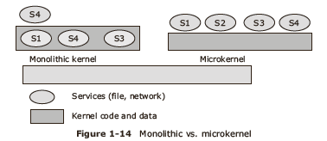
Monolithic versus Microkernel Approach

Slide 20
Reliability
  Availability in case of Hardware failure
  Data recovery in case of Data failure
  Maintain consistency in case of replicated data

Slide 21
Performance
Metrics are:
Response time,
Throughput,
System utilization
Amount of network capacity used

Slide 22
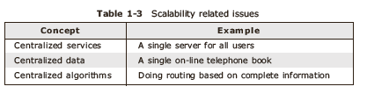
Scalability
Techniques to handle scalability issues
  hide communication latencies,
  hide distribution
  hide replication

Slide 23
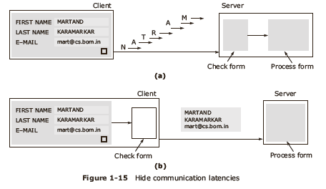
Hide communication latencies,

Slide 24
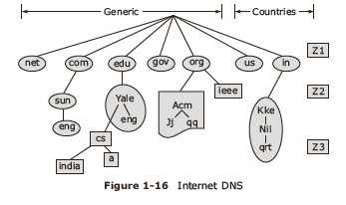
Hide distribution

Slide 25
Security
confidentiality means protection against unauthorized access;
integrity implies protection of data against corruption
availability means protection against failure always accessible.

Slide 26
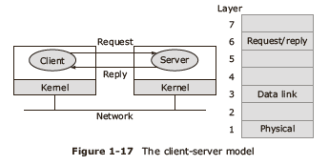
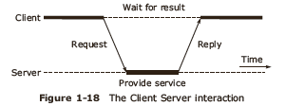
Client Server model
Client Server Interaction

Slide 27
Client Server addressing techniques
Machine addressing,
process addressing
Name server addressing

Slide 28
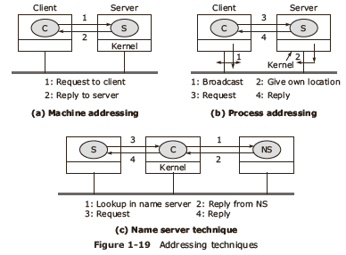
Client Server addressing techniques

Slide 29
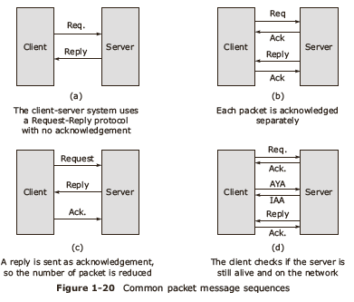
Client Server implementation
Messages for client server interaction
  Request, Reply, Acknowledge, Are you Alive, I am Alive.

Slide 30
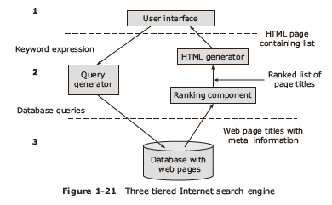
differentiation between the client and the server
User interface level
Processing level
data level

Slide 31
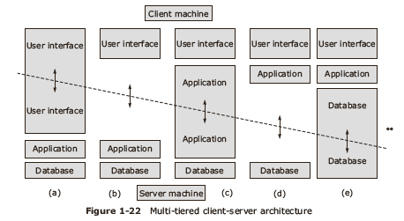
Client Server Architecture

Slide 32
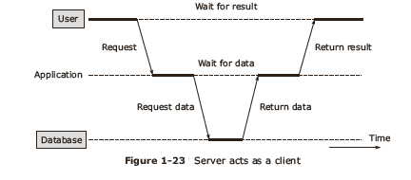

Slide 33
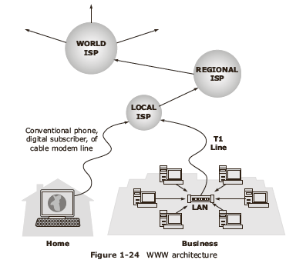
Case Study: World Wide Web 1.0

Slide 34
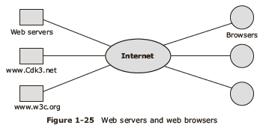
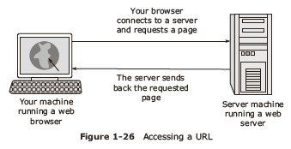
Internet scenario with web servers and web browsers

Slide 35
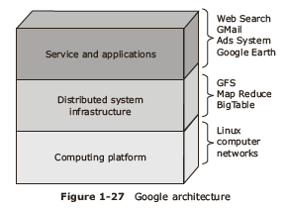
Case study: World Wide Web 2.0

Slide 36
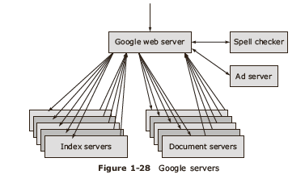
Case Study: Google Servers

Slide 37
Summary
Multiple-interconnected computers can have either shared memory or distributed memory architectures
Distributed systems offer integration of distributed applications, resource sharing, more reliability, better flexibility
Network operating system, distributed operating system and multiprocessor timesharing system are different types of distributed systems

